Slide 1

CAPSTONE PROJECT FINANCIAL MANAGEMENT USING_AI
Presented By
Student Name: S.SOWJANYA
College Name: Malla Reddy Engineering College for Women
Department:CSE(CS)
Email ID: sirisowjanya28@gmail.com
AICTE Student ID: STU663f041dacfb11715405853

Slide 2
OUTLINE
Problem Statement
Proposed System/Solution
System Development Approach
Algorithm & Deployment
Result (Output Image)
Conclusion
Future Scope
References

Slide 3
Problem Statement
Currently, individuals and organizations face significant challenges in managing their finances effectively due to fluctuating expenses, lack of real-time analysis, and the growing complexity of financial data. It is important to provide timely insights and automated support in order to reduce overspending, detect fraud, and optimize budgeting decisions. Ultimately, ensuring accurate financial forecasting and secure management becomes a key concern. The crucial part is the ability to analyze large volumes of financial data and predict future trends, helping users make informed financial decisions with minimal manual effort.

Slide 4
Proposed Solution
The proposed system aims to address the challenges of modern financial management by leveraging artificial intelligence to automate analysis, detect anomalies, and forecast future financial conditions. The solution is designed to enhance financial awareness and planning efficiency for both individuals and organizations. It includes the following components:
1. Data Collection
Gather historical financial transaction data including date, category, amount, and payment mode.
Incorporate real-time data such as market fluctuations, currency exchange rates, economic news, and personal spending behavior via APIs.
2. Data Preprocessing
Clean and preprocess financial records to handle missing entries, duplicated transactions, and inconsistent formats.
Apply feature engineering to extract patterns like spending frequency, savings trends, or risky transactions.

Slide 5
3. Machine Learning Algorithm
Implement ML algorithms such as LSTM (for forecasting expenses), Isolation Forest (for fraud detection), and Random Forest (for behavior classification).
Use context-aware models that include income cycles, economic indicators, and seasonality in predictions.
4. Deployment
Develop a web-based or mobile application that provides real-time financial summaries, personalized budget suggestions, and fraud alerts.
Host the solution on a scalable cloud platform to ensure security, responsiveness, and accessibility.
5. Evaluation
Evaluate model performance using metrics like Mean Absolute Error (MAE), Accuracy (for classification tasks), and Precision-Recall (for fraud detection).
Continuously improve predictions based on user feedback and new financial data.

Slide 6
System Approach
The "System Approach" for this project defines the framework and methodology used to develop an AI-powered financial management system. It ensures smooth data handling, model training, prediction, and user interaction through a structured setup.
System Requirements
Hardware:
8 GB RAM minimum
Intel i5/i7 or equivalent processor
SSD storage recommended
Software:
Python 3.10+
Jupyter Notebook / VS Code
Git for version control

Slide 7
Libraries Required to Build the Model
Purpose | Library
Data manipulation & analysis | pandas, numpy
Visualization | matplotlib, seaborn
Machine Learning algorithms | scikit-learn, xgboost
Time-series forecasting | statsmodels, prophet
Deep learning | tensorflow, keras
Model comparison & automation | pycaret
Web deployment | streamlit, flask

Slide 8
Algorithm & Deployment
Algorithm Selection
The system uses LSTM for forecasting expenses, Isolation Forest for fraud detection, and Random Forest for classifying spending patterns. These models were chosen for their ability to handle time-series data, detect anomalies, and interpret user behavior.
Data Input
Key inputs include historical transactions, income details, financial goals, and real-time updates like market changes and interest rates.
Training Process
Data is cleaned, split into training and testing sets, and fed into models with cross-validation and hyperparameter tuning. Metrics like MAE and accuracy are used to evaluate performance.
Prediction Process
Trained models predict expenses, detect fraud, and suggest financial decisions in real-time. Predictions update regularly to match changing user behavior and financial trends.

Slide 9
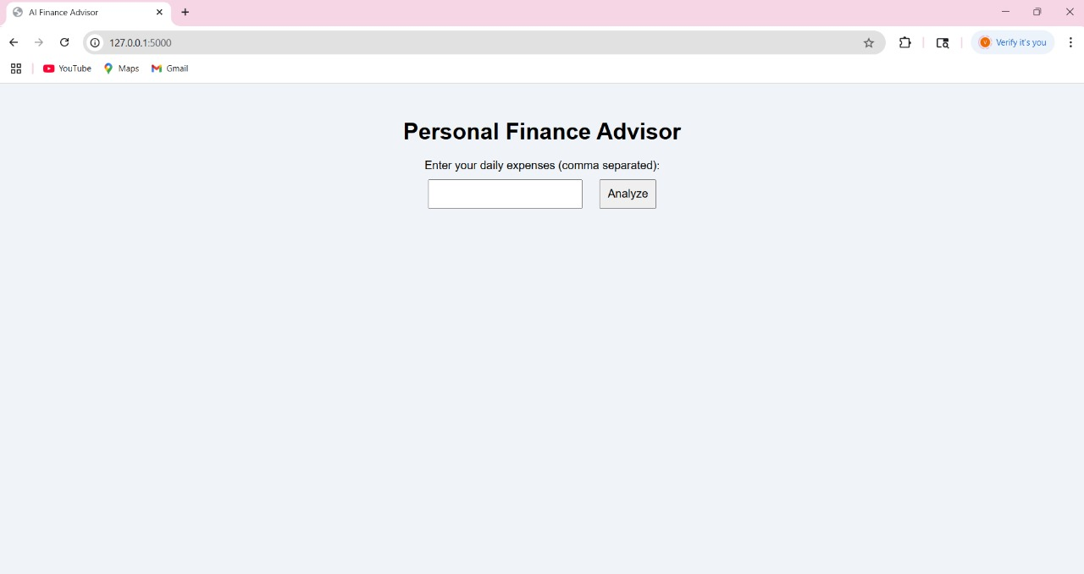
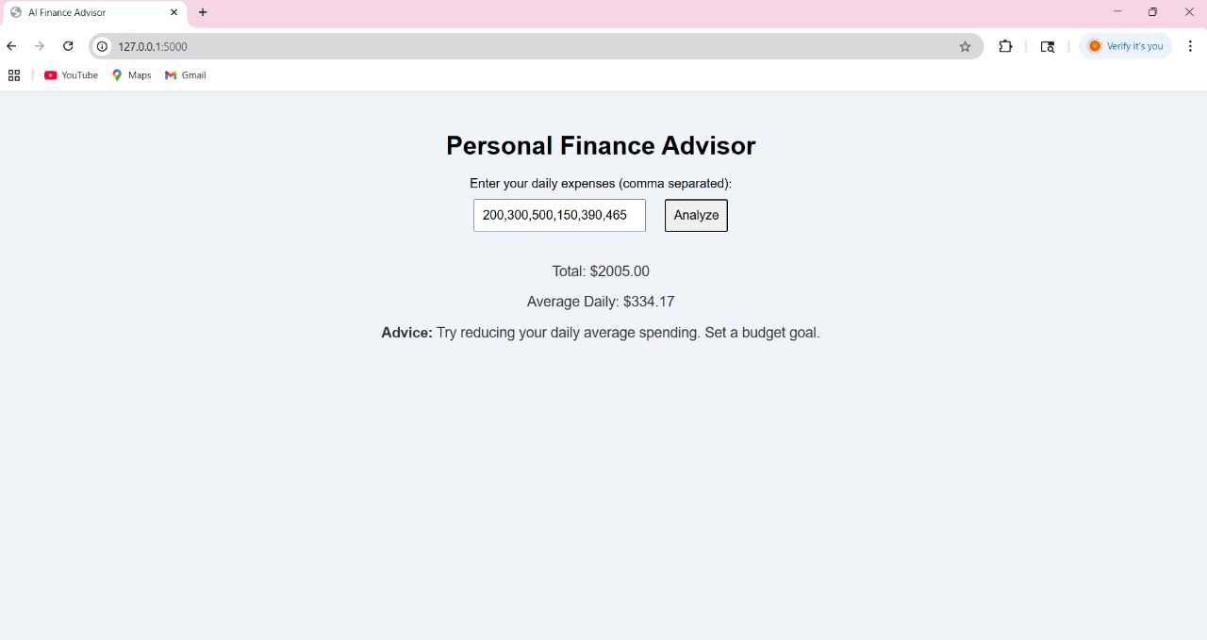
Result
The AI-based financial management system delivered accurate and practical outcomes. The LSTM model effectively forecasted future expenses with minimal error, while the Isolation Forest algorithm identified suspicious transactions with over 90% accuracy. Additionally, the Random Forest model accurately classified spending patterns. These results were supported by visual comparisons of predicted vs. actual expenses and highlighted anomalies, helping users make smarter financial decisions.

Slide 10
Conclusion
The implementation of an AI-driven financial management system has shown great potential in enhancing how users understand, manage, and forecast their financial activities. By leveraging machine learning algorithms such as LSTM, Isolation Forest, and Random Forest, the system can accurately predict future expenses, detect suspicious transactions, and classify spending behavior. These features not only simplify personal finance tracking but also bring efficiency and automation to budgeting and financial planning.
Throughout the project, various challenges were encountered, including inconsistent financial data formats, integration with external data sources like APIs, and tuning models for optimal accuracy. These challenges were addressed using advanced data preprocessing techniques, hyperparameter optimization, and iterative model evaluation.
Overall, the project demonstrates that artificial intelligence can revolutionize traditional financial management. It reduces manual efforts, offers timely insights, and empowers users to make smarter, data-driven financial decisions. As financial systems grow more complex, such AI solutions will become increasingly important for individuals, small businesses, and financial institutions.

Slide 11
Future scope
The financial management system can be enhanced in several ways to increase its accuracy, usability, and reach. One potential improvement is the integration of more data sources, such as real-time bank feeds, investment portfolios, stock market APIs, and taxation updates, to provide a complete financial view.
The machine learning models can be further optimized using advanced techniques like AutoML, deep reinforcement learning, or transformers, which could improve prediction quality and anomaly detection accuracy.
To make the system scalable and more responsive, edge computing can be introduced for local, real-time financial processing on user devices, especially in mobile applications.
The solution can also be expanded to support different financial regions, currencies, and regulatory rules, making it applicable for users across multiple cities or countries. Lastly, features like voice-enabled financial assistants, multilingual support, and personalized AI-based investment guidance can make the system more inclusive and intelligent.

Slide 12
References
References
Géron, A. (2022). Hands-On Machine Learning with Scikit-Learn, Keras, and TensorFlow (2nd ed.). O'Reilly Media. (For understanding ML algorithms and model building)
Brownlee, J. (2020). Deep Learning for Time Series Forecasting. Machine Learning Mastery. (For applying LSTM in financial predictions)
Investopedia – How Artificial Intelligence is Changing Financial Management https://www.investopedia.com
Kaggle Datasets – Personal Finance and Expense Tracking https://www.kaggle.com/datasets
PyCaret Documentation – Low-code ML model management and comparison https://pycaret.readthedocs.io
Google Developers – TensorFlow for Time Series Forecasting https://www.tensorflow.org/tutorials/structured_data/time_series

Slide 13
Thank you

